Slide 1
Instructor Guide
Feel free to localize examples throughout to better tailor to your audience
For the lecture portion of the class, each process slide is followed by examples of a particular ethical concern with that step in the process
Related material, potentially of interest

Slide 2
Ethics in Data Visualization
A Visualizing the Future Module

Slide 3
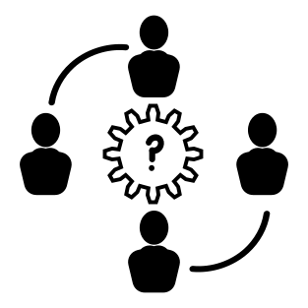
Intro Question
What has made a problematic chart for you in the past? When you have seen a problematic chart, what has been the problem? What are some past problems you’ve seen in charts? When has a chart made you question its validity?
[if you can’t think of anything problematic…]
How did you learn about a problematic design technique?
tinyurl.com/0521vizandtell
Notes:
Alternatives:
What do you think about when you think about ethics in data visualization? (more advanced audience)
(younger audience - some combination)
How do you tell if a picture is fake?
How do you tell if data/pictures are trustworthy?
How do you identify bias in data? Research? Pictures? News?

Slide 4
Ideal Schedule
Lecture 15-20min lecturing including individual/ small group reflection questions
1st Activity (full group) 15-20min
2nd Activity (small group) 30-50 ideally,

Slide 5
Learning Objectives
List the five steps in the data visualization creation process: select topic, problem, or question; acquire data; clean data; analyze data; create the visualization
Understand how decisions in the steps up to data visualization can affect the final visualization
Identify common sources of bias in the data visualization process
Practice ethics-centered data visualization design

Slide 6
Defining ethics
“a set of moral principles, especially ones relating to or affirming a specified group, field, or form of conduct.”
(OED)
Notes:
Begin with some definitions.
-Ethics are not fixed, they can be negotiated. Important to be upfront about what one’s ethics are and make sure that decisions along the way reflect those ethics rather than just a series of accidental choices.
-Morals are determined by individuals for themselves, laws are geopolitical, and ethics are usually on someone’s behalf (generally professional) -Cogley, B. From Headlines to Headway - Conference Data Ethics Presentation
-There’s no right way to do a data visualization but there are several wrong ways. Most important to make these decisions intentionally as opposed to accidentally.

Slide 7
Data Is Not Neutral
Notes:
It’s affected by all the decisions made throughout the data’s lifecycle from collection to visualization/publication
No such thing as raw data - all data has been curated (Cogley, 2019; Barrowman, 2018; Hall, 2008)
Data is affected by its cultural and institutional contexts and the decisions of people handling the data (Barrowman, 2018)
Data is taken, as opposed to given as pre-existing fact, and is therefore subject to human knowledge production which is situated, contextual, and partial (Drucker, 2011) - capta

Slide 8
The process: Select topic, problem, or question
Select topic, problem, or question
Acquire data
Clean data
Analyze data
Why is this study being done?
Who benefits from the outcome of this study? Who might be harmed?
Am I the right person to do this research?
If appropriate, have I preregistered my research?
Notes:
Why is this study being done?
Will this research actually contribute to new understanding or change? It is very demoralizing to be studied and then have nothing come from it.
If using secondary data, do you have the data you need to really answer the research question?
Who benefits from the outcome of this study? Who might be harmed?
Is there a conflict of interest that might bias analysis/communication? This is a situation where confirmation bias might show up, both while framing the research question and while gathering the data.
Will the study exclude participants, thus preventing them from benefiting from research? (Ozeran, 2019)
Are participants being protected throughout the process?
Is this population over-burdened by research?
Am I the right person to do this research?
“What knowledge gaps do I have?” (Cogley, 2018a)
Have I built trust with this community?

Slide 9

Exclusion because of research scope
Focusing a study of heart attack symptoms on symptoms that are more common for men, like chest pain
Focusing a study of child cereal preference on healthy cereals but not accounting for nut allergies
Focusing a study of library satisfaction on physical spaces, ignoring distance students
Notes:
Icon: case study by Tomas Knopp from the Noun Project
Alternative approach: populations who are overburdened:
Surveying students during a busy time when they have also received surveys from multiple other campus groups
Asking community members to participate in a study about their experience of urban renewal activities when there is a history of this population participating in multiple similar studies previously (especially if they have seen no benefit)

Slide 10
The process: Acquire data
Select topic, problem, or question
Acquire data
Clean data
Analyze data
What choices were made about collection method, participant selection, questions included, etc.? What influenced those choices?
Are the people represented by the data being treated with dignity? Have they been included in the decision-making process? Are you minimizing the burden and risk placed on them?
Will the data you have answer your research question?
Have you cited the source of any secondary data?
Notes:
Collecting the data yourself:
“Do the people represented in this data have control over how it’s collected?” (Cogley, 2018b) How were they included in the data process? Can they opt out?
Are you collecting more data than you need? Or not enough?
One example of not having enough data: if your data breaks down by demographics but one group is a very small percentage of the population, you may have a small number of participants in that group and run the risk of either re-identifying them or misrepresenting them by having only a few people included in the sample. You may want to proactively oversample from these groups. If you do so, you may need to weight the analysis based on the known proportions of the population to re-balance when computing global averages.
What are you consciously not collecting? Why?
Note: sometimes not collecting certain demographics categories is important, and other times it perpetuates marginalization. For example, the citizenship question on the 2020 Census would have had a silencing effect, but failing to record gender and race in certain circumstances makes it impossible to identify bias experienced by subsets of the participants.
Do you have reason to believe the data you’re collecting will answer the question you’re asking?
Secondary data:
Who collected the data?
How was the data collected? In what context (setting, assumptions, limits, etc.)?
What options appeared in the survey instrument (drop down vs. free form)?
how subjective are the measures? (Cogley, 2019)
how is null recorded (Cogley, 2020)
can we collect data that does not fit our categories (D’Ignazio & Klein, 2016)
Ex. Patient records - for the care and treatment of a patient - patient may be reluctant to disclose information
Were participants included in the data process?
Who do I need to give credit to for collecting the data?

Slide 11
Bias introduced by taking shortcuts
Conducting psychology experiments only with students enrolled in introductory psychology courses, ignoring the bias that introduces in the population (age, gender, educational background, race/ethnicity, etc.) [see Availability Bias]
Participant exclusion because focus group is held in the evening when nontraditional students might have caretaking responsibilities
Participant exclusion by advertising study only to certain listservs
Exploring community dynamics on Twitter but only looking at public tweets

Slide 12
The process: Clean data
Select topic, problem, or question
Acquire data
Clean data
Analyze data
What assumptions are you making about the data? Are there other interpretations?
Are you removing any data from the analysis? Will that introduce systematic bias into the analysis?
Are you simplifying data for the analysis? How does the loss of that complexity influence your results? Are your participants still being well represented by the data?
Have you given appropriate credit to anyone who helped with data cleaning?
Notes:
What data has been normalized in the data cleaning process?
What assumptions have been made?
What has been left out?
How are outliers handled? - how can that data be maintained?
Who do I need to give credit to for cleaning the data?

Slide 13
Complications related to data aggregation
Survey respondents from underrepresented minorities are often grouped together to avoid identification, but this decision also leads to the erasure of these groups.
Students with low GPAs are grouped together in a category (“<3.5 GPA”) even though over 85% of students in this category have a GPA under 2.5
Choosing a large bin size when looking at poverty across counties in a state hides an important bimodal pattern.

Slide 14
The process: Analyze data
Select topic, problem, or question
Acquire data
Clean data
Analyze data
Are you applying appropriate analysis methods / statistical tests to the data you have?
Are you fully exploring data interactions and alternative explanations?
Do you know enough about the data to interpret the results?
Are you explicitly declaring all of the limitations of this analysis?
Have you given appropriate credit to anyone who helped with data analysis?
Notes:
What assumptions have been made?
What or who has been left out? Why?
Who do I need to give credit to for analyzing the data?

Slide 15
Bias introduced by assumptions
Misunderstanding a hashtag that is meant to indicate sarcasm and, thus, coding a series of tweets as having positive sentiment instead of negative
Ignoring gender because it wasn’t expected to be an issue, only later to realize that there was an issue with sexual harassment in the survey population
Seeing an anomalous 50% drop in counts as a data collection problem, when really there was a global pandemic that year

Slide 16
Accounting for these decisions in our final visualization
Ask these questions of collaborators or yourself if you’ve been completing all the steps in the process.
Show the process
Give credit
Fill in personal knowledge gaps by consulting literature, subject experts, and, if human-subject data is involved, work put out by members of the community being visualized
Create the visualization

Slide 17
Ethical decisions when visualizing data
What are we selecting and emphasizing? How can we show these decisions? (Ozeran, 2019)
How are the aesthetics affecting the tone of the visualization? (Ozeran, 2019)
“What values are you espousing in your visualization? Do they support or conflict with other values?” (Cogley, 2020)
Are you naturalizing or challenging a broader worldview? (Naerland, 2020)
Create the visualization
Notes:
What is being left out? Why? (Ozeran, 2019)
Cogley, 2020
Does your design diminish the topic? Consider how it’s interpreted without reading the words.
Do you create overt alarm? Most people are already stressed.
Does it overly abstract and calm too much? Some people aren’t taking this seriously enough.
Is the data viz a respectful treatment of the material/ topic?
Naerland, 2020
“Consider for instance how data visualizations can frame socio-economic disparities as dramatic and critical, or conversely, as natural and inevitable. Such worldviews promoted through data visualizations may in turn be highly significant in legitimating or challenging the priorities of political bodies or actors, or in informing voting preferences.”

Slide 18
Know Your Audience
Both intended and unintended
Conscious of historical context and what may come after (datapractices.org)
People can feel recognized, misrecognized, and unrecognized in data visualization (Naerland, 2020)
Work towards increasing benefit and preventing harm (datapractices.org)
What gaps might our audience have and what narrative needs to be added? (Cogley,2018a)
Does the visualization empower the audience? (D’Ignazio & Klein, 2016)
Notes:
(Naerland, 2020) - Media constantly mirror back images of their audiences - important source for recognition - people can feel recognized, misrecognized, and unrecognized in data visualization
“Who will be using the visualization? To what end? Will decisions be made that can affect human welfare, whether mental, physical, financial, etc.? Will sharing this visualization violate anyone’s privacy, or right to self-determination? How might the visualization be used or misused for political purposes?” (Ozeran, 2019)
“promote empathy for the people whom the data represents. For example, if you are representing death, a minimalist, “objective” visualization may not be the best way to respect those people. Second, promote empathy for your audience. Make your visualization accessible, usable, and understandable. Provide ways for them to learn more based on questions that may arise from viewing your visualization.” (Ozeran, 2019)

Slide 19
Large group visualization discussion

Slide 20
The Fries that Bind Us and The Magic Bean Shop
Notes:
The next two visualizations (next slide side by side) include great examples of how color, contrast, size, etc. can impact the readability and accessibility of visualizations and be misleading.

Slide 21
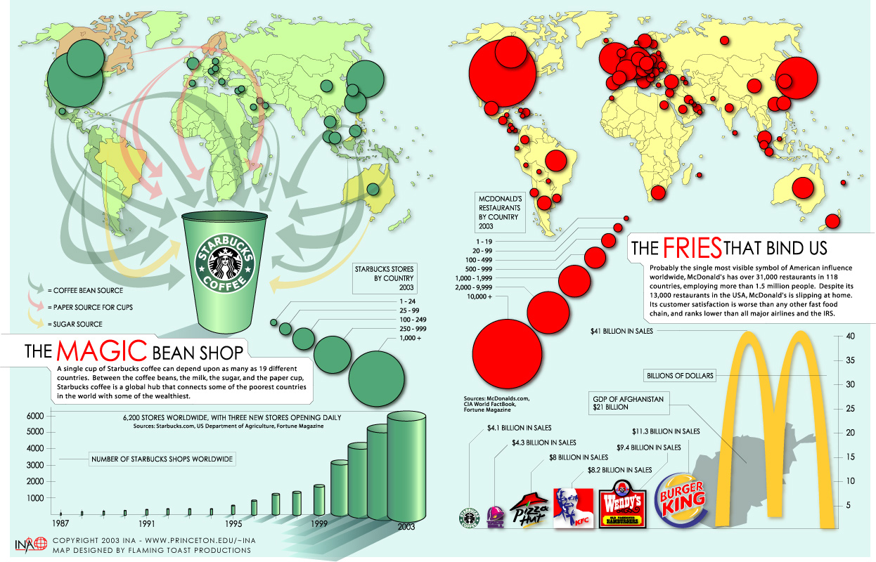
The Magic Bean Shop and the Fries That Bind Us
Notes:
Country colors almost entirely invisible, and confusing that the light green color isn’t really a data color, just the default country color; possible issue with red/green color blindness
Arrows are unclear, hard to follow, and the contrast is likely too low; possible issue with red/green color blindness
The circles cover up the map
Size of circles not proportionate (legend suggests data were binned, so size isn’t continuous, and the circle area doesn’t seem to represent well either the low value of the bin or the high value)
Size of logos not proportionate (distorts the data by changing both width and length instead of just length, like a bar chart)
3D chart -- makes it harder to read, also distorts the data by changing volume instead of just length

Slide 22
Reflection (small group)
What is one strategy you will (or already do) use to center ethics in the data visualization process?
Notes:
Options:
Which step of the data visualization process do you feel most confident about in terms of identifying ethical concerns? Least confident about?
What is one strategy you will (or already do) use to center ethics in the data visualization process?

Slide 23

Mapping Census (ACS) Data Activity
Based on Hepworth & Church, 2018
Notes:
Icon: demographic by Nithinan Tatah from the Noun Project

Slide 24
Mapping Census Data Group Activity Instructions
Split class into groups of 5-6 people
Each group receives the same 2 maps showing Income Below Poverty by County in Mississippi.
Context: We want to understand the relationship between gender and poverty in Mississippi by county. Mississippi is one of the poorest states in the US.
Each group is given one of the following questions (only one question per group):
What conclusions would you draw about any effect of gender on poverty levels in Mississippi?
Are there any misleading components of the maps?
Is there any information that is missing that would be necessary for interpreting these maps?
Share each group’s question and their response and discuss all together
Notes:
If there are students who are not familiar with Census or American Community Survey data, a brief overview can be included.
Here is a good brief guide: https://guides.lib.berkeley.edu/USCensus/ACS

Slide 25
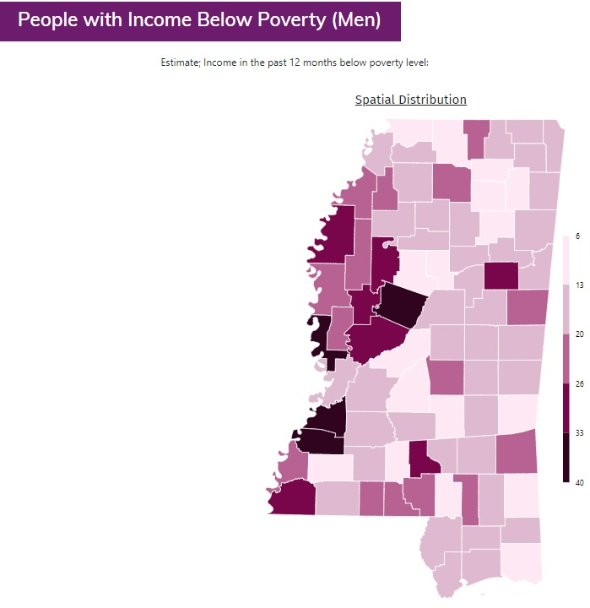
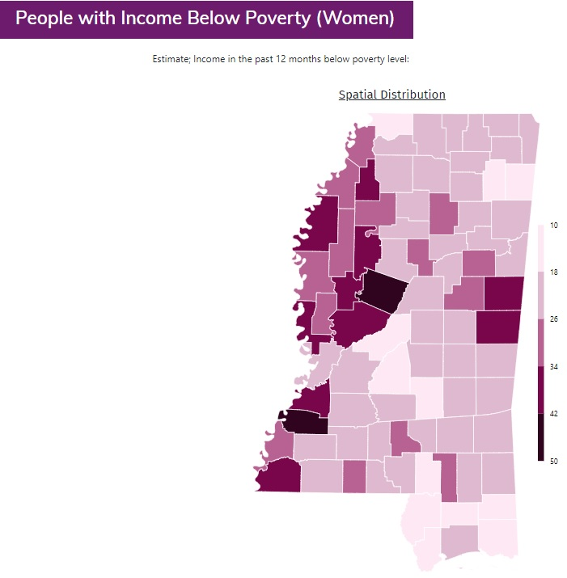
Mapping Census (ACS) Data: Poverty and Gender
Note: Maps display percent of each demographic group below poverty by county. Poverty thresholds vary depending on the size of the family unit and the number of children under 18 years in the family. In 2018, the poverty threshold for an individual under 65 years is $12,784. For a family of four (two parents, two children) the threshold is $25,465. For each additional child, the threshold increases by between $3,000 and $5,000. The thresholds for each year since 1978 can be found here: https://www.census.gov/data/tables/time-series/demo/income-poverty/historical-poverty-thresholds.html
Notes:
Instructor “solutions” for discussion after each group has shared their responses to their assigned questions:
Generally, the distribution across counties seems similar for men and women, with women experiencing higher levels of poverty overall and in some specific counties
The maps and note are missing specifics about the source of the data. Is it decennial Census? American Community Survey? From what year? Also missing north arrow, scale bar, label identifying the state as Mississippi.
For context, we might need to know the general population density for each county.
Advanced: the data classification method used results in different scales for each map, making it more difficult - or not possible - to make direct comparisons across groups

Slide 26
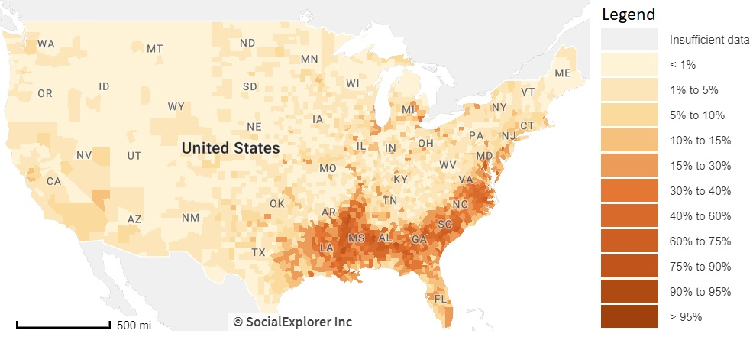
Mapping Census Data: A Critical Lens
A challenge with Census data: it is often stratified by one demographic variable (e.g. income below poverty by gender).
Consider Kimberlé Crenshaw’s theory of intersectionality
“Crenshaw describes the social construction of multiple identities as overlapping systems of discrimination.”
Also consider this map of the distribution of African-American people across the US by county:
Notes:
Sources:
Crenshaw, Kimberlé. 1989. "Demarginalizing the Intersection of Race and Sex: A Black Feminist Critique of Antidiscrimination Doctrine, Feminist Theory and Antiracist Politics." University of Chicago Legal Forum 1989, Article 8:139-167.
Koli, F., Nadasen, P. and Rod, A.B. “(Un)Privileging the Map: A Community Collaboration in Understanding Economic Security”, proceedings of the MAPPING (IN)JUSTICE SYMPOSIUM: Digital Theory + Praxis For Critical Scholarship, Fordham University, New York, New York, USA. (2019). Available at: https://mappinginjustice.org/unprivileging-the-map-a-community-collaboration-in-understanding-economic-security/

Slide 27
Challenging Assumptions
Did we know enough about the history of Mississippi to be able to interpret the relationship between poverty and gender?
Should the map creator(s) have investigated the intersection of race and gender as it relates to poverty in Mississippi?
Examining positionality: Who is benefitting from this work?
“Mapping inequality is not impactful in and of itself. Must continuously ask ourselves: are our practices creating the knowledge by which communities can build power?” (Koli 2019)
Notes:
Bonus: ask which step of the data visualization process relates to each assumption

Slide 28
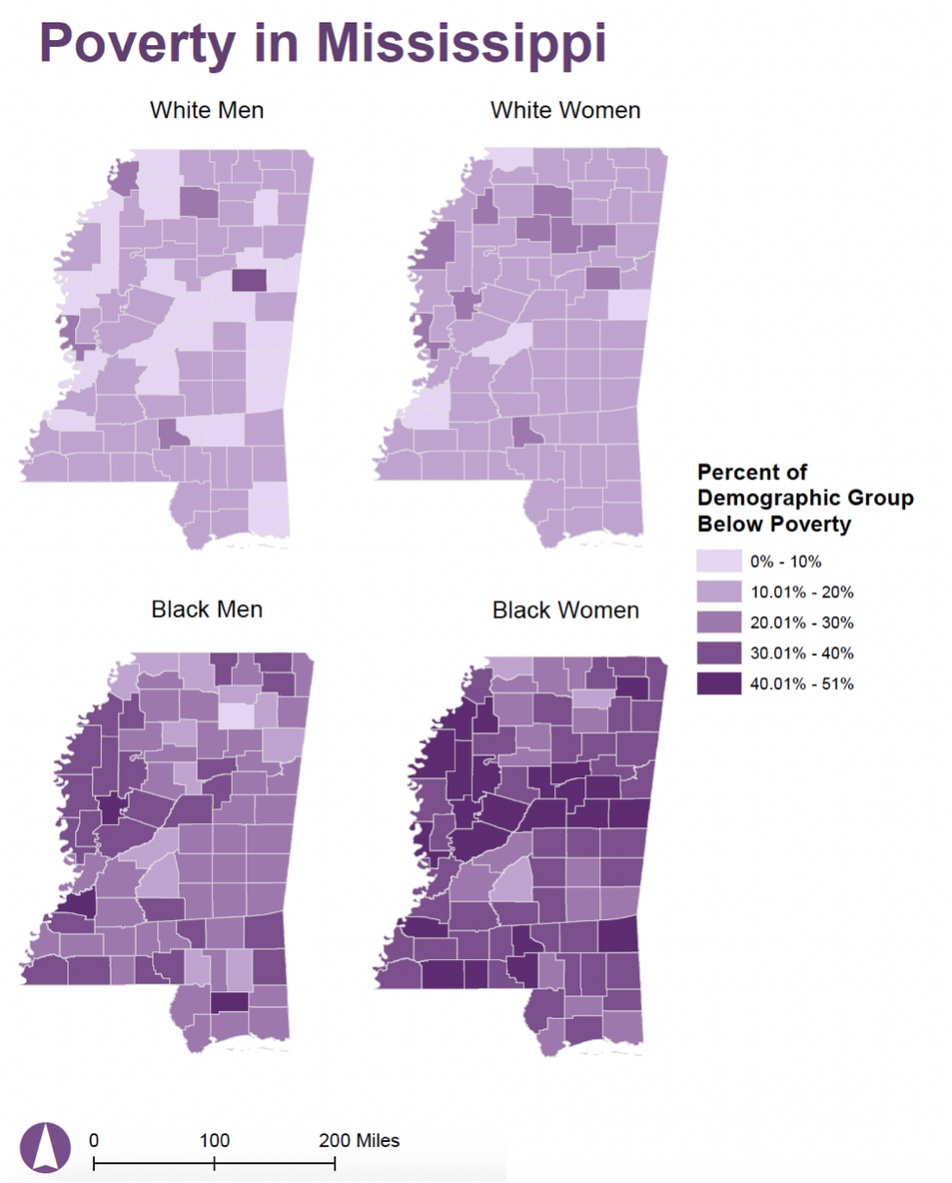
Mapping ACS Data: Race and Gender and Poverty
Source: 2012 ACS 5-year estimates. Koli, F. “(Un)Privileging the Map: A Community Collaboration in Understanding Economic Security.” Paper presented at the MAPPING (IN)JUSTICE SYMPOSIUM: Digital Theory + Praxis For Critical Scholarship. Fordham University / November 7-9 2019
Notes:
Discussion questions:
Now looking at poverty stratified by both race and gender, what do the visualizations reveal?
Which group is most affected by poverty across Mississippi?
Instructor notes:
Taking an intersectional approach looking at poverty by both race and gender reveals that Black women are most affected by poverty across Mississippi. It highlights the limitations of exploring gender absent race. Black men face higher rates of poverty than white women, but this would be rendered invisible if aggregated with data on white men
The power granted to maps and data, which in many cases can and has led to the reinforcement of oppressive structures, is also the reason why they have the potential to be used to bring attention to those oppressive structures.

Slide 29

Redesigning Economist Charts
Group Activity
Notes:
Icon: chart by Setyo Ari Wibowo from the Noun Project

Slide 30
Redesigning Economist Charts
Group Activity Instructions
Split class into groups of 2-4 people
Each group will receive a chart
Answer the following questions about the chart:
What message is the chart trying to get across?
What is misleading about this chart or preventing the message from getting across?
With the above questions in mind, how would you redesign the chart? Sketch out or use your preferred visualization software to redesign the chart.
Share redesigns and discuss.
Notes:
[slide that you would show the class]

Slide 31
Redesigning Economist Charts
Group Activity Instructions (for instructor)
Split class into small groups (2-4 people)
Give each group an original chart from https://medium.economist.com/mistakes-weve-drawn-a-few-8cdd8a42d368
Ask each group to answer the following questions about the chart:
What message is the chart trying to get across?
What is misleading about this chart or preventing this message from getting across?
With the above questions in mind, how would you redesign the chart? Sketch out or use your preferred visualization software to redesign the chart.
If possible, pop into each group briefly to make sure they’re not overwhelmed/spiralling
Ask each group to share their redesign and show the better versions from the article.
Discuss the misleading and confusing elements and if the group found something different than the article. Great chance to talk about differences in perspectives and the many ways to visualize the same data.
If demonstrating a particular software, you could also demonstrate how to adjust scale and colors
Notes:
Possible concern is that students may not be as familiar with Western economics concepts like trade deficit, GDP, and surplus so maybe be prepared to provide some context if needed
Some interesting themes that might come up in discussion: who is the likely audience of this publication? What can they be expected to understand?
If these examples are not great for your audience, here are some other thoughts:
https://www.alteryx.com/input/coronavirus-data-visualizations-and-how-charts-lie
https://www.makeovermonday.co.uk/makeovers/
https://nsgrantham.shinyapps.io/tidytuesdayrocks/
Three levels of interpretation of the actual redesign:
What principles of “good design” / “bad design” do you see here? How do they change from initial design to redesign?
What do you think this redesign says about the context in which it was released (The Economist) and the intended audience? Why do you think this team made these decisions?
What ideas and assumptions are embedded in this redesign? What might the team have done differently (ie missed in the redesign) that could have helped the audience understand the ideas better?

Slide 32
What were the solutions from
The Economist?

Slide 33
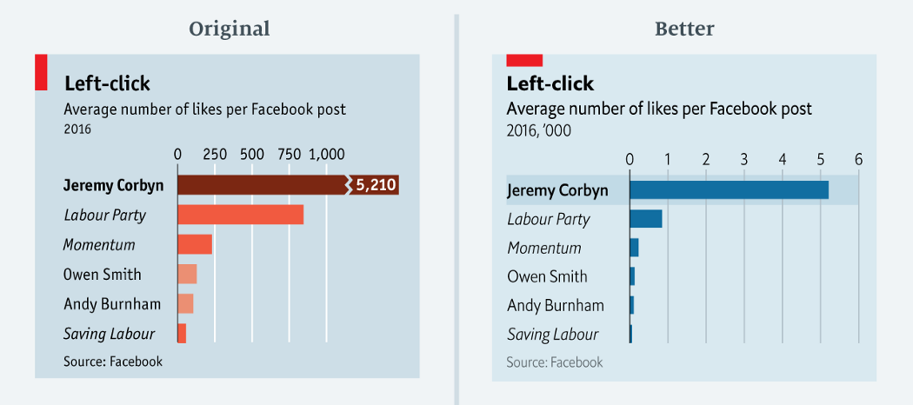
Left-click
https://medium.economist.com/mistakes-weve-drawn-a-few-8cdd8a42d368
Notes:
Message the chart is trying to get across: How far Jeremy Corbyn surpasses other British political parties and candidates in the number of Facebook likes.
What is misleading about this chart or preventing this message from getting across: The truncated scale.
Other improvements made to the chart: move to a single color for the bars
Other things to note: Potential confusion of thousands notation in better chart
Easy

Slide 34
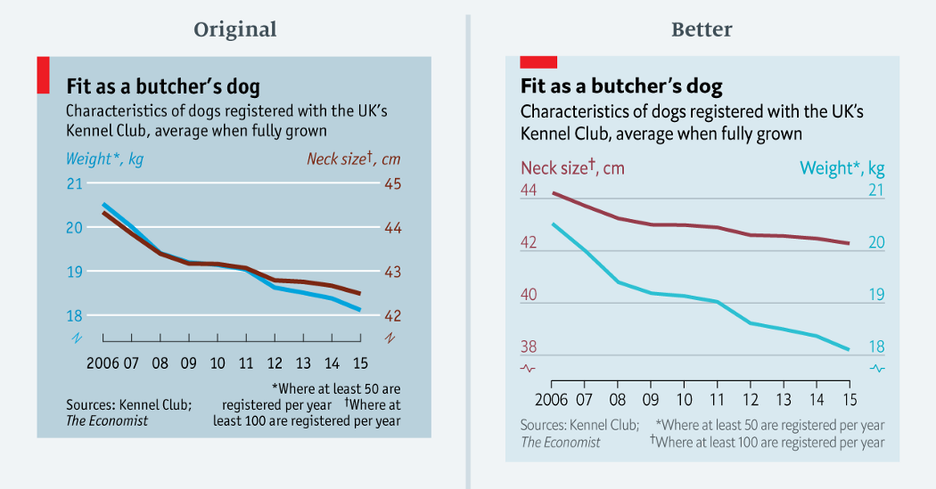
Fit as a butcher’s dog
https://medium.economist.com/mistakes-weve-drawn-a-few-8cdd8a42d368
Notes:
Message the chart is trying to get across: Neck size and weight dogs registered with the UK’s Kennel Club are decreasing at the same rate
What is misleading about this chart or preventing this message from getting across: Forced relationship by selecting scales. Issues of indexing, starting point of a scale.
Difficult
Note: this might be difficult to pick out. The way to see the difference is look at difference in percentage. Could be a class example with the whole class at the end (either work through whole thing as a big group discussion or present the before to everyone and have them break out again to brainstorm redesigns) or challenge question (try this in your small group if you finish early).

Slide 35
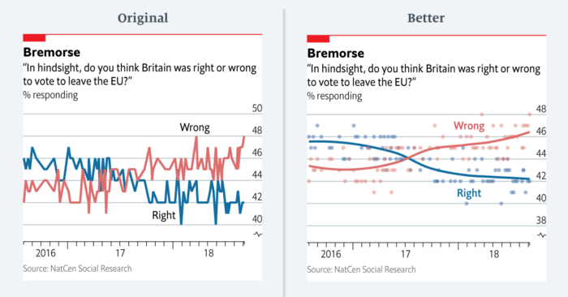
Bremorse
https://medium.economist.com/mistakes-weve-drawn-a-few-8cdd8a42d368
Notes:
Message this chart is trying to get across: Increasing number of respondents believe it was wrong for Britain to leave the EU, decreasing number of respondents believe it was right for Britain to leave the EU
What is misleading about this chart or preventing this message from getting across: Hard to see the general trend with the line chart type, overemphasizes the smaller fluctuations
Easy

Slide 36
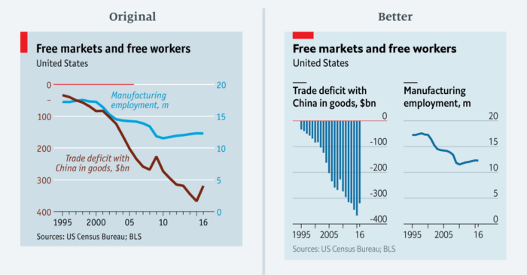
Free markets and free workers
https://medium.economist.com/mistakes-weve-drawn-a-few-8cdd8a42d368
Notes:
Message this chart is trying to get across: Relationship between trade deficit with China and manufacturing employment, trade deficit is increasing while manufacturing employment is decreasing
What is misleading about this chart or preventing this message from getting across: Difficult to read because left axis is negative and reads top to bottom, where the right axis reads from bottom to top
Hint for the group: look at the axes
Medium

Slide 37
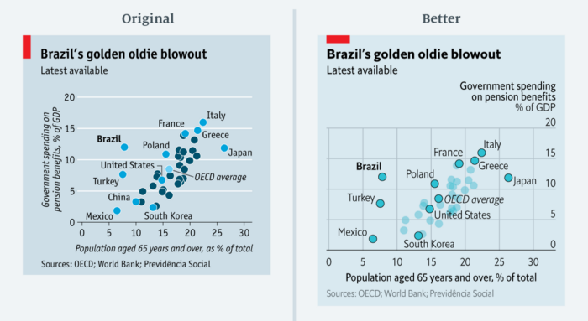
Brazil’s golden oldie blowout
https://medium.economist.com/mistakes-weve-drawn-a-few-8cdd8a42d368
Notes:
Message this chart is trying to get across: Brazil is paying a lot in pension considering it has a small portion of the population over 65, with other countries highlighted for comparison
What is misleading about this chart or preventing this message from getting across: color (specifically hue) implies there are different groups when there are no categories, multiple colors are distracting
Something to note: Inclusion of both gridlines to better highlight the intersection between the age and spending, why were these countries chosen to be labeled?
Easy

Slide 38
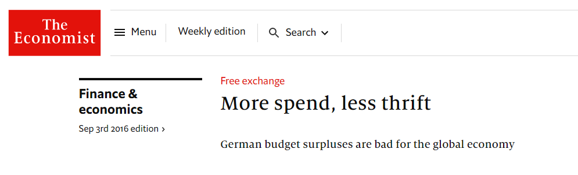
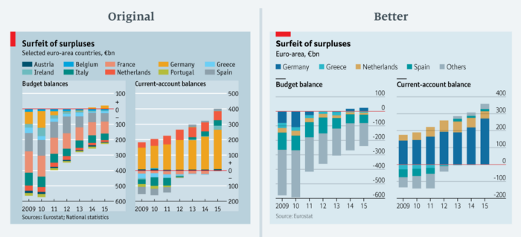
Germany compared to Greece, Netherlands, and Spain in the article
https://medium.economist.com/mistakes-weve-drawn-a-few-8cdd8a42d368
Notes:
Message this chart is trying to get across: Highlight the amount of surplus in Germany’s budget (very hard to get just by looking at the chart - better understanding of context based on article it appears in)
What is misleading about this chart or preventing this message from getting across: Too many colors, too many countries included (accompanying article only mentioned a few countries)
Note: probably should not be a stacked chart because positive and negative amounts not added together. Not sure if this is common in economics.
Might make more sense as a Fishbone diagram or waterfall chart
Medium (with article context) - easy fix for design, harder if you think about the numbers

Slide 39
Other possible questions when critiquing a visualization:
Who is the intended and unintended audience?
Who collected, processed, and visualized the data? Was this information easy to find?
Why was the data collected, processed, and visualized? Was this information easy to find?
How was the data collected, processed, and visualized? Was this information easy to find?
What is the focus? What is being left out?
What assumptions are being made?
What tone is being set by the aesthetics of this visualization?
What established worldviews does this visualization support or challenge?
What is the effect of using political borders (county, state) to group the data?
Does the visualization empower the audience?
Have all steps been taken to increase benefit and reduce harm in producing and publishing this visualization?

Slide 40
References
Barrowman, N. (2018). Why data is never raw. New Atlantis 56: 129-135.
Cogley, B. (2018, October 29). From headlines to headway - Tableau conference data ethics presentation. TableauFit. Retrieved from: https://www.tableaufit.com/from-headlines-to-headway-tableau-conference-data-ethics-presentation/
Cogley, B. (2018, November 28). The quantified life and data ethics: Thinking beyond privacy. TableauFit. Retrieved from: https://www.tableaufit.com/the-quantified-life-and-data-ethics-thinking-beyond-privacy/
Cogley, B. (2019, September 5). How we collect data matters. TableauFit. Retrieved from: https://www.tableaufit.com/how-we-collect-data-matters/
Cogley, B. (2020, March 30). The ethics of visualizing during a pandemic. TableauFit. Retrieved from: https://www.tableaufit.com/the-ethics-of-visualizing-during-a-pandemic/
D’Ignazio, C., & Klein, L. F. (2016). Feminist data visualization. In Workshop on Visualization for The Digital Humanities (VIS4DH), Baltimore. IEEE. Retrieved from: http://vis4dh.dbvis.de/papers/2016/Feminist Data Visualization.pdf
Datapractices.org
Drucker, J. (2011). Humanities approaches to graphical display. Digital Humanities Quarterly 5(1). Retrieved from: http://www.digitalhumanities.org/dhq/vol/5/1/000091/000091.html
Hall, P. (2008). Critical Visualization. In Design and the Elastic Mind, edited by Paola Antonelli. 122-131. New York: Museum of Modern Art.
Hepworth, K., & Church, C. (2018). Racism in the machine: Visualization ethics in digital humanities projects. Digital Humanities Quarterly 12(4). Retrieved from: http://www.digitalhumanities.org/dhq/vol/12/4/000408/000408.html
Naerland, T.U. (2020). The political significance of data visualization: Four key perspectives. In Data Visualization in Society, ed. M. Engebretsen & H. Kennedy. Amsterdam: Amsterdam University Press. doi: 10.5117/9789463722902_ch04
Ozeran, M. (2019). Ethics of data visualization. Position statement for Visualizing the Future Symposium.
Quinn, M. J. (2013). Ethics for the Information Age. Upper Saddle River, NJ: Pearson.

Slide 41
Icons
case study by Tomas Knopp from the Noun Project
demographic by Nithinan Tatah from the Noun Project
chart by Setyo Ari Wibowo from the Noun Project

Slide 42
Questions?

Slide 43
Summative Assessment Questions (proposed)
What step of the data visualization ethics process is affected the most by whether you gather data yourself or use someone else’s data?
Ways to empower the audience include:
Citing your data source
Making a visualization interactive
Documenting the data cleaning process
Using aggregation to provide an overview
When designing data visualizations, ethical considerations influence:
Choice of data source
Choice of color scheme
Choice of visualization software
Choice of chart type
Notes:
Add the correct answers

Slide 44
For instructor reference: Additional examples

Slide 45
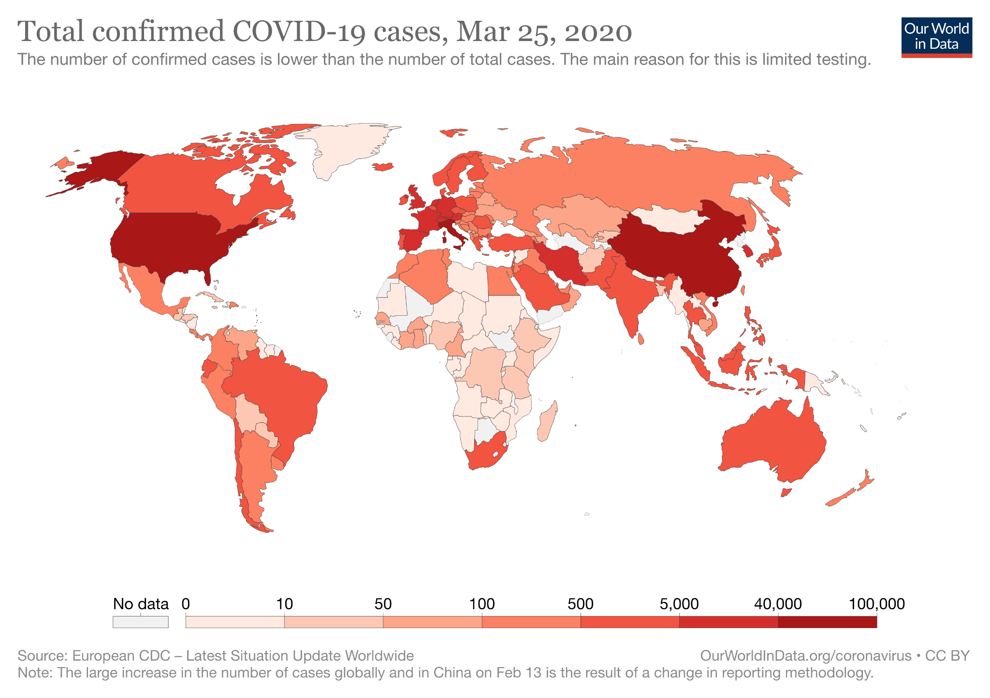
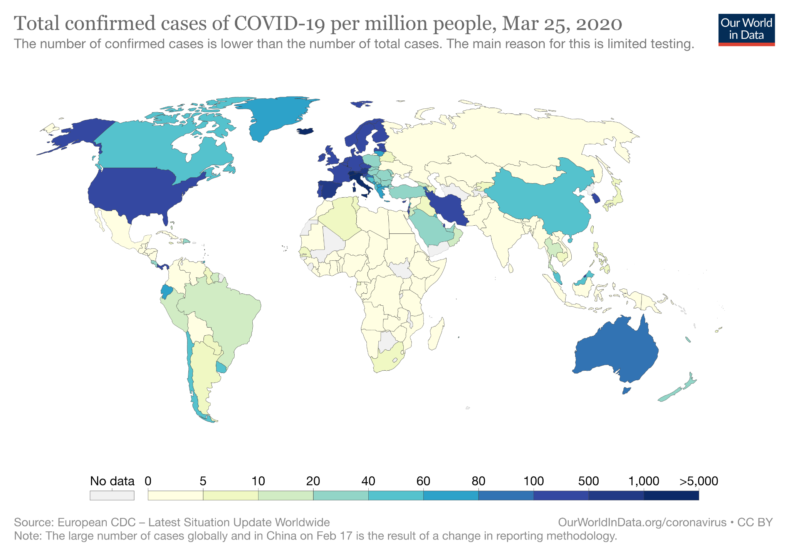
Total confirmed COVID-19 cases, March 25, 2020
Source: Our World in Data via https://www.alteryx.com/input/coronavirus-data-visualizations-and-how-charts-lie

